Slide 1
Atoms and Elements
Matter Part 2

Slide 2
Structure of an Atom
Nucleus: Tiny center of an atom made up by protons and neutrons
Proton: Subatomic particle with a positive charge

Slide 3
Structure of an atom cont.
Neutron: Subatomic particle with no charge
Electron: Subatomic particle with a negative charge
  Surrounds the nucleus

Slide 4
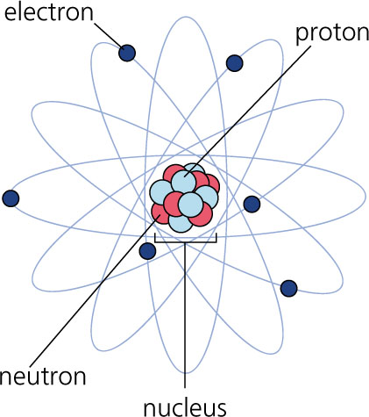

Slide 5
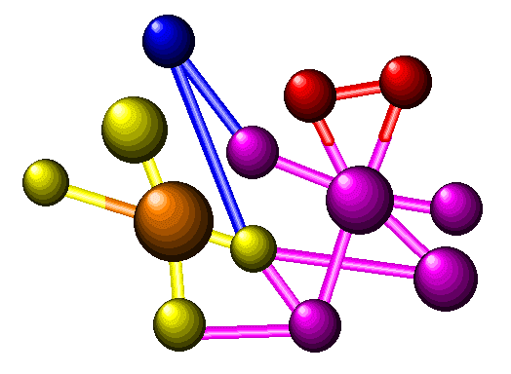
Elements
Element: A substance made up of only one kind of atom
Atom: Smallest unit of an element that has all the properties of that element
Molecule: Formed when two or more atoms are linked together

Slide 6
Common Elements
Oxygen
Sodium
Aluminum
Helium
Chlorine
Iron
Click arrows to play short video

Slide 7
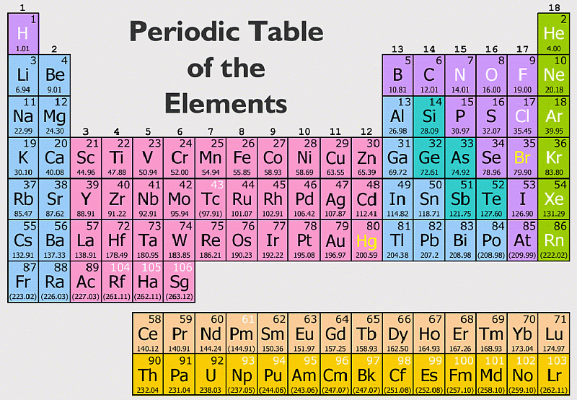
Periodic Table
Periodic Table: The table of elements in order of increasing atomic number; grouped by similar properties
Listen

Slide 8
Atomic Number: Number of Protons in one atom
  Example:
    Oxygen has 8
    Hydrogen has 1
19
Atomic Number
K
Chemical Symbol: Abbreviation of element name
Potassium
Element Name

Slide 9
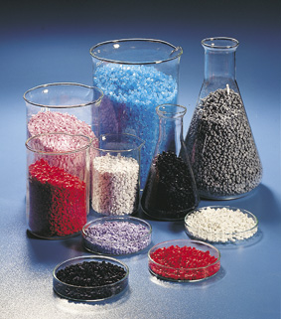
Compounds
Compounds: A substance made of the atoms of two or more elements
  Water is one of the most common compounds (Hydrogen and Oxygen Atoms)

